Slide 1






Modelling the effectiveness of the fox eradication program for local shorebirds on Philip Island
Udani A. Wijewardhana
Faculty of Arts, Health and Design Swinburne University of Technology
Supervisor: Professor Denny Meyer
Associate supervisors: Dr. Madawa Weerasinghe
Dr. Pragalathan Apputhurai

Slide 2


Introduction
» Predator control methods, according to Berryman (1972), include environmental modification, biological control, mechanical barriers and repellents, trapping and transplanting, hunter harvest, controlled killing and economic reimbursement.
» Australian conservation managers have used a range of actions to reduce predation pressure in order to recover threatened species over the recent decades.
» It is possible to use predator abundance data, when available, to estimate the probability of eradication success (Samaniego-Herrera et al. 2013), using levels of search efforts and times for the last predator sign recorded.
» An alternative approach is to use prey abundance as the measure of success.
BEST FOR You
O R G A N I C S C O M P A N Y

Slide 3
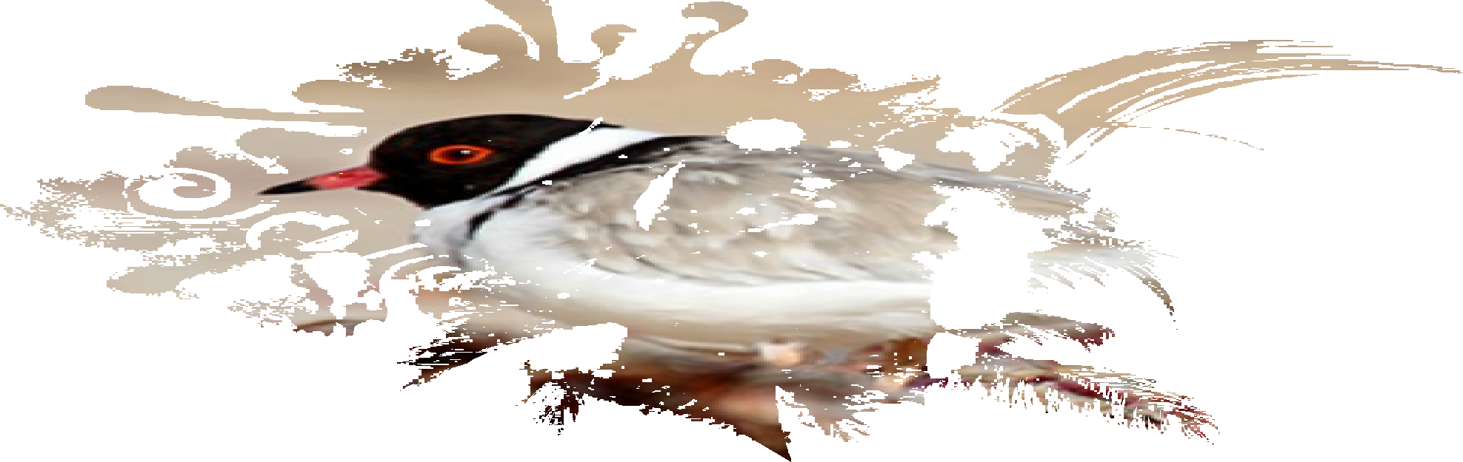



Case Study
» No assessment has been conducted to identify the effectiveness of the fox eradication program in the context of local shorebirds on the Phillip Island.
» We considered the eradication of red foxes (Vulpes vulpes) from Phillip Island in Victoria, Australia as a means of controlling the predation of shorebirds.
» We selected only the most common Phillip Island shorebirds, namely the Black-fronted Dotterel (Elseyornis melanops), Black-winged Stilt (Himantopus himantopus), Masked Lapwing (Vanellus miles), Pied Oystercatcher (Haematopus longirostris) and locally threatened Sooty Oystercatcher (Haematopus fuliginosus) and Hooded Plover (Thinornis rubricollis).
» As the measure of success of the fox eradication program, we used the increase in population of these shorebird species during the period.
BEST FOR You
O R G A N I C S C O M P A N Y

Slide 4
Case Study: Fox eradication program
» Fox control measures had been practised since around 1918 (Gabriel 1919), mainly to protect ground-nesting shorebirds and seabirds (Norman 1971), and a specialised fox-control team was established on Phillip Island in the early 1980s.
» These initial efforts had not been successful, and a further eradication program was launched in 2006, with three phases of knock-down, clean-up, and post-eradication.
» The initial knock-down phase focused on the poisoning of red foxes, use of bait through the island, augmented by spotlight shooting, trapping, den fumigation and destruction, and hunting with dogs (PestSmart Connect, 2012).
» An effective knock-down was declared in 2011, when a decrease of the fox population was recorded in fox sign, sightings and catch-effort data.
» The clean-up phase required further efforts in addition to island-wide intensive baiting with a range of bait types (PestSmart Connect, 2012) and efforts to prevent fox migration across the bridge.
BEST FOR You
O R G A N I C S C O M P A N Y

Slide 5
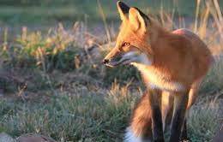
Methodology: Data Analyses
» We have focused on annual aggregated data (taking into account the location of each sighting) since the eradication milestones were detected annually.
» Annual records for local shorebirds on Phillip Island were obtained from the Atlas of Living Australia database (ala.org.au, 2020) between 2002 and 2017.
» The annual resident human population data was obtained from the Australian Bureau of Statistics (abs.gov.au, 2020).
» To cross validate our results, we have considered estimated fox population numbers for the same period (Kirkwood, Sutherland, Murphy and Dann, 2014).
BEST FOR You
O R G A N I C S C O M P A N Y

Slide 6
Methodology: Temporal Integrated Laplace Approximation (INLA) model
» The Integrated Laplace Approximation model (INLA) is a popular robust approximation tool for fitting Bayesian models rather than the traditional Markov Chain Monte Carlo (MCMC) (Paul et al. 2010).
» The key advantages of R-INLA are, the ease to write and modify complex codes for complex models and the speed at which inference can be done even for spatial problems with hundreds of thousands of observations.
» INLA allows a wide range of different functions: GLMM, GAMM, spatial autocorrelation, temporal autocorrelation, and spatiotemporal models. Combining this variety with its (eventual) simplicity and computational efficiency.
» This is becoming increasingly important in ecology.
» In spatial-temporal settings, it is often assumed that the covariance is separable in space and time. Thus, the temporal structure has modelled using an auto-regressive process (AR(1)) and spatial structure has modelled using stochastic partial differential equations (SPDE).
BEST FOR You
O R G A N I C S C O M P A N Y

Slide 7
Methodology: Temporal Integrated Laplace Approximation (INLA) model
» Temporal INLA modelling allows for the effect of spatial autocorrelation in the data, thereby producing more accurate models.
» In this instance, we hypothesise an increasing trend in shorebird abundance in response to the fox eradication program.
» An autoregressive model was fitted to the residuals to account for the short-term fluctuation of the abundance trend and a fixed effect was assumed for the year in order to account for the long-term trend.
» We added resident human population to our model in order to control these threats as well as to control certain biased factors inherent in our citizen science data. This was on the assumption that citizen science activity had increased on the island in conjunction with the resident human population.
» The number of visitors to the island are large, yet since it is only seasonal during the summer holiday period, the data could be ignored.
BEST FOR You
O R G A N I C S C O M P A N Y

Slide 8
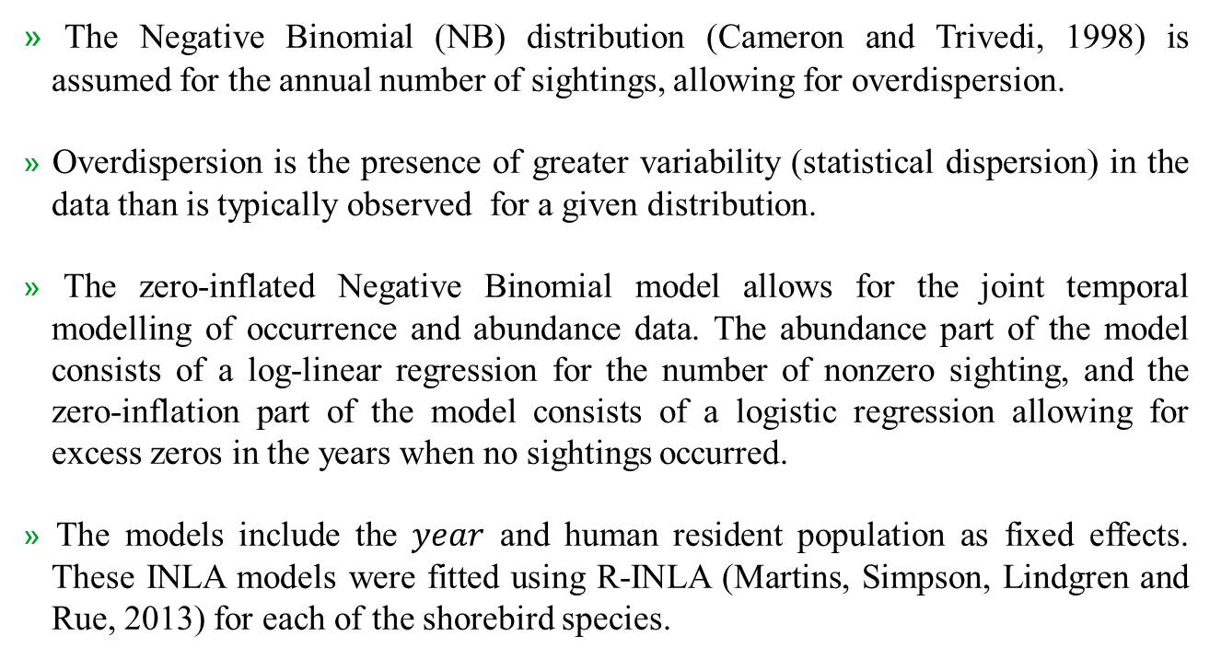
Methodology: Temporal Integrated Laplace Approximation (INLA) model
» The Negative Binomial (NB) distribution (Cameron and Trivedi, 1998) is assumed for the annual number of sightings, allowing for overdispersion.
» Overdispersion is the presence of greater variability (statistical dispersion) in the data than is typically observed for a given distribution.
» The zero-inflated Negative Binomial model allows for the joint temporal modelling of occurrence and abundance data. The abundance part of the model consists of a log-linear regression for the number of nonzero sighting, and the zero-inflation part of the model consists of a logistic regression allowing for excess zeros in the years when no sightings occurred.
» The models include the $year$ and human resident population as fixed effects. These INLA models were fitted using R-INLA (Martins, Simpson, Lindgren and Rue, 2013) for each of the shorebird species.
BEST FOR You
O R G A N I C S C O M P A N Y

Slide 9
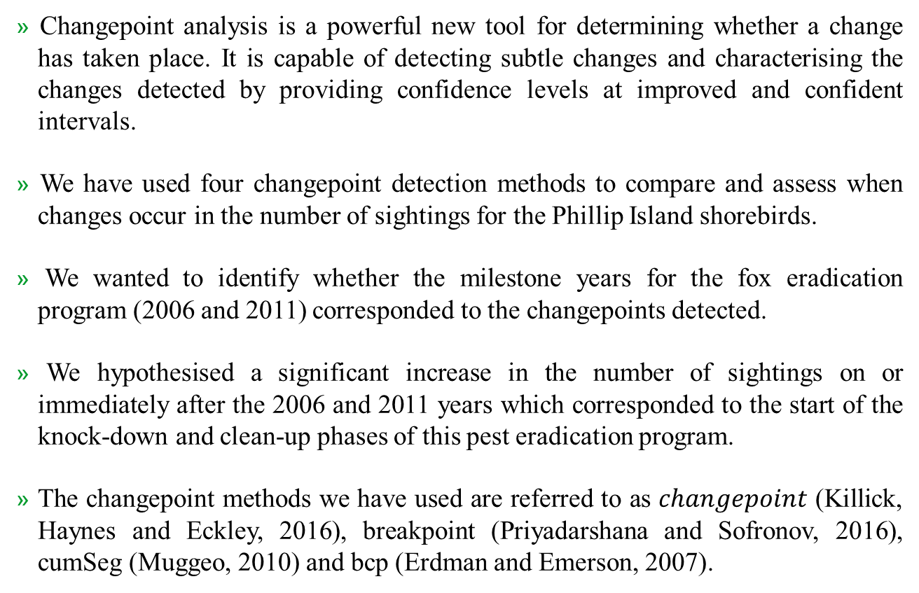
Methodology: Changepoint analysis
» Changepoint analysis is a powerful new tool for determining whether a change has taken place. It is capable of detecting subtle changes and characterising the changes detected by providing confidence levels at improved and confident intervals.
» We have used four changepoint detection methods to compare and assess when changes occur in the number of sightings for the Phillip Island shorebirds.
» We wanted to identify whether the milestone years for the fox eradication program (2006 and 2011) corresponded to the changepoints detected.
» We hypothesised a significant increase in the number of sightings on or immediately after the 2006 and 2011 years which corresponded to the start of the knock-down and clean-up phases of this pest eradication program.
» The changepoint methods we have used are referred to as $changepoint$ (Killick, Haynes and Eckley, 2016), breakpoint (Priyadarshana and Sofronov, 2016), cumSeg (Muggeo, 2010) and bcp (Erdman and Emerson, 2007).
BEST FOR You
O R G A N I C S C O M P A N Y

Slide 10
Methodology: Changepoint analysis
» The analyses were conducted using various R packages.
» The changepoint package implements various mainstream and specialised changepoint methods for finding single and multiple changepoints within data which includes many popular non-parametric and frequentist methods.
» The breakpoint package implements variants of the Cross-Entropy method to estimate both the number and the corresponding locations of break-points in biological sequences of continuous and discrete measurements. This method was primarily built to detect multiple break-points in genomic sequences.
» The cumSeg package estimates the number and location of change points in mean-shift (piecewise constant) models has also been used to model genomic sequences of continuous measurements. The algorithm first estimates the highest number of change points using the efficient ‘segmented’ algorithm of Muggeo (2003) and then selects some of these change points using a generalized BIC criterion using the Least Angle Regression (LAR ) algorithm of Efron et al. (2004).
» The bcp package provides an implementation of the Barry and Hartigan (1993) product partition model for the normal errors change point problem using Markov Chain Monte Carlo.
BEST FOR You
O R G A N I C S C O M P A N Y

Slide 11
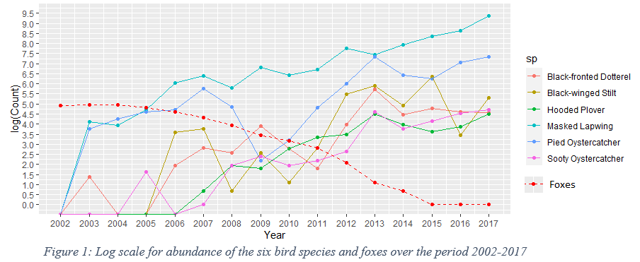
Results
» Since 2004 the abundance for all frequently observed shorebirds on Phillip Island has increased significantly, suggesting that predation has reduced or that citizen science reporting has increased.
» Figure 1 illustrates these changes in the abundance of the six local shorebird families on a log scale for the period 2002-2017, together with estimated fox numbers for this period (Kirkwood et al, 2014). The decline in fox numbers appears to be matched by increases in shorebird numbers.
BEST FOR You
O R G A N I C S C O M P A N Y

Slide 12
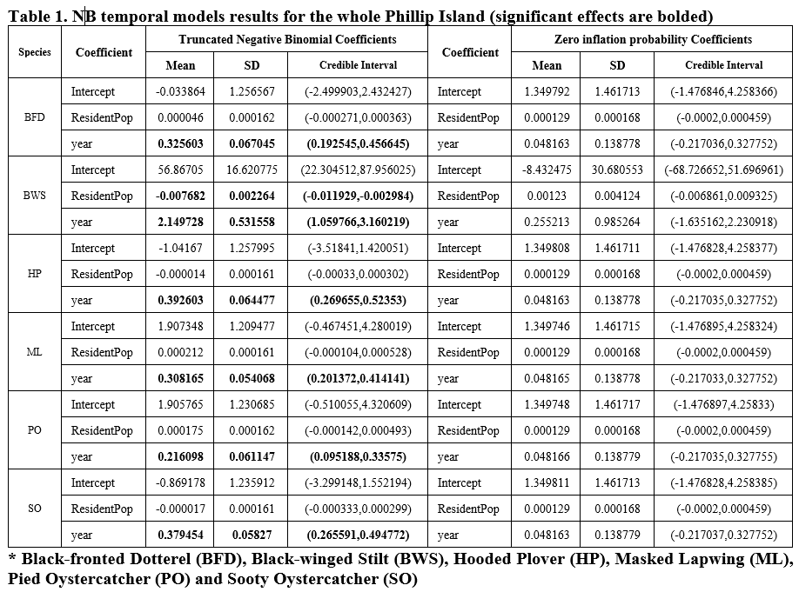
Results
» The effect of the resident population has been found to be non-significant for five of the species reported and significantly negative for the BWS, suggesting that it is unlikely that increased citizen science reporting is responsible for this change.
BEST FOR You
O R G A N I C S C O M P A N Y

Slide 13
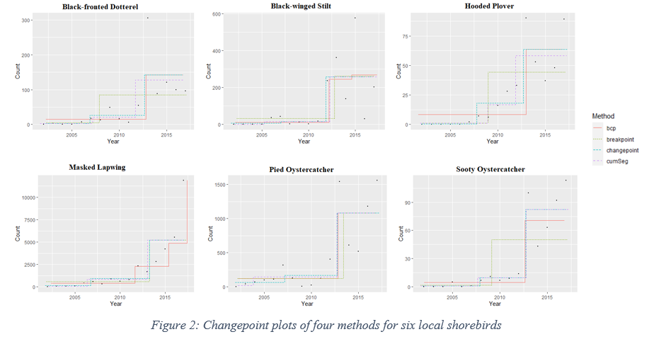
Results
» The steps of Figure 2 shows the changepoints.
BEST FOR You
O R G A N I C S C O M P A N Y
Notes:
Plots of these four changepoint methods are shown in Figure 2. The steps of Figure 2 show the changepoints. The x-axis displays the year from 2002-2017 and the y-axis displays the mean number of sightings for the $changepoint, cumSeg$ and $breakpoint$ methods and the posterior probability of a changepoint for the $bcp$ method. The bcp method uses a probability of 0.7 as the threshold required to identify a changepoint. All these methods consistently identified the start of the clean-up phase (2011/2012). There was less consistency in the case of the start of the knock-down phase, although the $changepoint$ method did consistently identify the start of this period as 2006/2007 for all species.

Slide 14
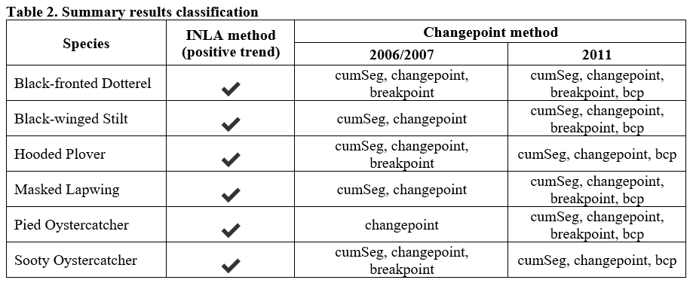
Results
» Table 2 shows a summary of the results, assuming that the start of the knock-down phase should have produced an increase in shorebird numbers in the 2006/2007 period.
BEST FOR You
O R G A N I C S C O M P A N Y
Notes:
Table 1 shows a summary of the results, assuming that the start of the knock-down phase should have produced an increase in shorebird numbers in the 2006/2007 period. The failure of the bcp method to identify the start of the knock-down period can probably be attributed to the high 70% threshold set for this method.

Slide 15
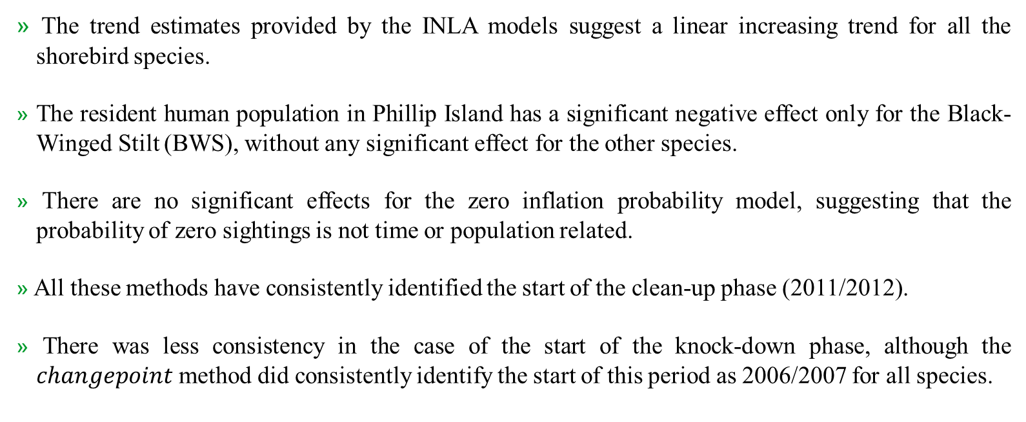
Results
» The trend estimates provided by the INLA models suggest a linear increasing trend for all the shorebird species.
» The resident human population in Phillip Island has a significant negative effect only for the Black-Winged Stilt (BWS), without any significant effect for the other species.
» There are no significant effects for the zero inflation probability model, suggesting that the probability of zero sightings is not time or population related.
» All these methods have consistently identified the start of the clean-up phase (2011/2012).
» There was less consistency in the case of the start of the knock-down phase, although the $changepoint$ method did consistently identify the start of this period as 2006/2007 for all species.
BEST FOR You
O R G A N I C S C O M P A N Y

Slide 16
Conclusion
These results confirm that the staging of the knock-down and clean-up stages of the fox eradication program were aligned with the abundance of shorebirds.
In particular this was true for the locally threatened Hooded Plover and Sooty Oystercatcher, which means that the eradication program milestones detected in this way can be effective for threatened shorebird species.
By accommodating temporal variation INLA models have been shown to be capable of modelling the effects of a pest eradication program in a reliable manner, suggesting that these models can be used for assessing other conservation efforts in the future.
These results suggest that changepoint methods can be considered as useful tool for assessing the effectiveness of conservation efforts over time, perhaps assisting with the scheduling of changes in the conservation management when appropriate.
The results of this study suggest that there may be other areas in which citizen science data can be beneficial for conservation management, reducing costs while stimulating more public interest in conservation.
This study has suggested that the monitoring of prey, even secondary types of prey, can provide useful confirmation for deciding when programs designed to eradication pests can be judged a success, allowing these programs to move into their post-eradication phases.
BEST FOR You
O R G A N I C S C O M P A N Y

Slide 17
References
Western Port Shorebirds Education Kit for Grades 5 & 6 Introduction Section A -Western Port Acknowledgements. (2018). Retrieved from https://birdlife.org.au/documents/EDU-Western-Port-Shorebird-Kit.pdf
PestSmart Connect. (2012). Case study: Foxes on Phillip Island. [online] Available at: https://pestsmart.org.au/pestsmart-foxes-on-phillip-island/ [Accessed 21 Apr. 2020]
Ala.org.au. (2020). Atlas of Living Australia. [online] Available at: https://www.ala.org.au/.
Abs.gov.au. (2020). Australian Bureau of Statistics, Australian Government. [online] Available at: https://www.abs.gov.au/.
Cameron, A.C., Trivedi P.K. Regression Analysis of Count Data; Cambridge University Press: Cambridge, UK, 1998.
Guénette, J.-S., and M.-A. Villard. 2004. Do empirical thresholdstruly reflect species tolerance to habitat alteration? EcologicalBulletins 51:163-171 (2) (PDF) Threshold detection: Matching statistical methodology to ecological questions and conservation planning objectives. Available from: https://www.researchgate.net/publication/273777417_Threshold_detection_Matching_statistical_methodology_to_ecological_questions_and_conservation_planning_objectives.
Muradian, R. 2001. Ecological thresholds: a survey. EcologicalEconomics 38:7-24. http://dx.doi.org/10.1016/S0921-8009(01)00146-X.
Toms, J. D., and M. L. Lesperance. (2003). Piecewise regression: atool for identifying ecological thresholds. Ecology 84:2034-2041.http://dx.doi.org/10.1890/02-0472 (2) (PDF) Threshold detection: Matching statistical methodology to ecological questions and conservation planning objectives. Available from: https://www.researchgate.net/publication/273777417_Threshold_detection_Matching_statistical_methodology_to_ecological_questions_and_conservation_planning_objectives.
BEST FOR You
O R G A N I C S C O M P A N Y

Slide 18






Acknowledgement
We thank the Ministry of Higher Education
in Australia for providing a
Research (RTPS)
for this
Training scholarship research.
Program grant as
Stipend funding
Thank You
Udani Wijewardhana
+61 412 550 289
uwijewardhana@swin.edu.au
http://www.linkedin.com/in/udani-wijewardhana-2134426b
http://www.udaniwijewardhana.com/

